Slide 1
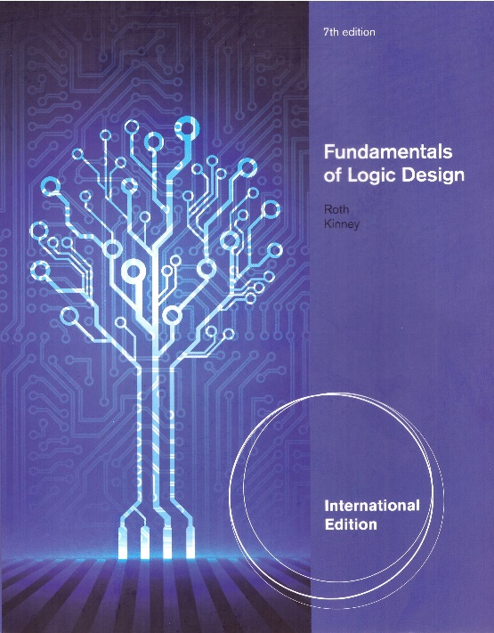
Unit 7
MULTI-LEVEL GATE CIRCUITS / NAND AND NOR GATES
This chapter in the book includes:
Objectives
Study Guide
7.1 Multi-Level Gate Circuits
7.2 NAND and NOR Gates
7.3 Design of Two-Level Circuits Using NAND
and NOR Gates
7.4 Design of Multi-Level NAND- and
NOR-Gate Circuits
7.5 Circuit Conversion Using Alternative Gate Symbols
7.6 Design of Two-Level, Multiple-Output Circuits
7.7 Multiple-Output NAND and NOR Circuits

Slide 2
Objectives
Topics introduced in this chapter
Design a minimal two-level or multi-level circuit
Design or analyze a two-level gate circuit
Design or analyze a multi-level gate circuit
Convert circuits by adding or deleting inversion bubbles
Design a minimal two-level or multiple-output circuit using
Karnaugh maps

Slide 3
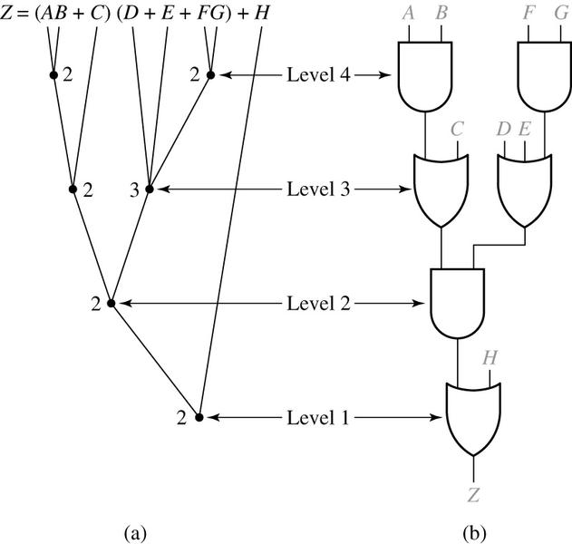
7.1 Multi-Level Gate Circuits
Terminology
AND-OR, OR-AND, OR-AND-OR, AND and OR
Four-Level Realization of Z

Slide 4
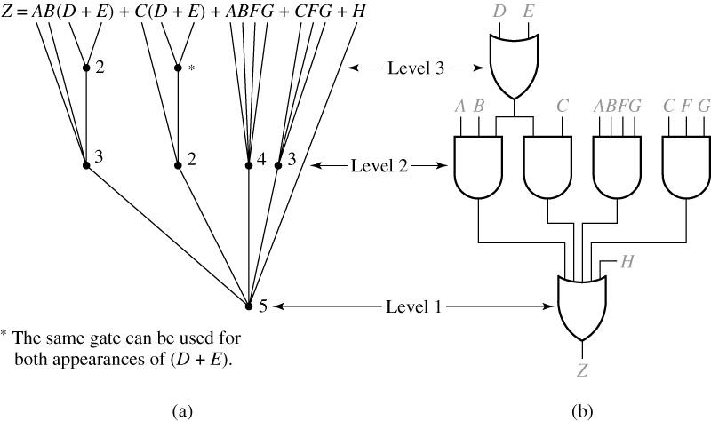
7.1 Multi-Level Gate Circuits
Three-Level Realization of Z

Slide 5
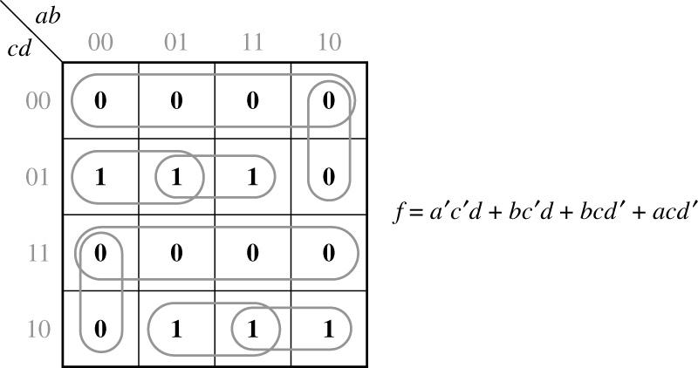
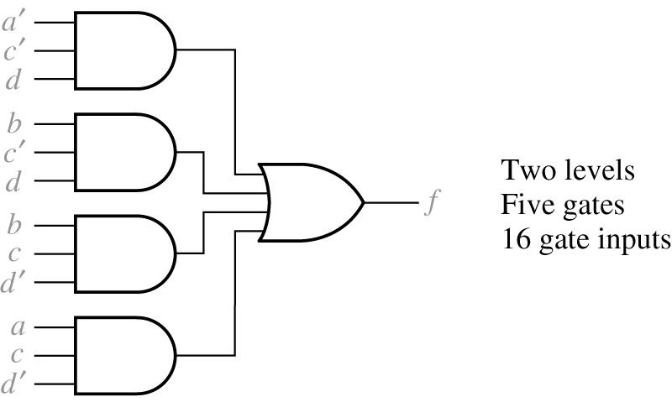
7.1 Multi-Level Gate Circuits
Example : Multi-Level Design Using AND and OR Gates
Two-level AND-OR gate

Slide 6
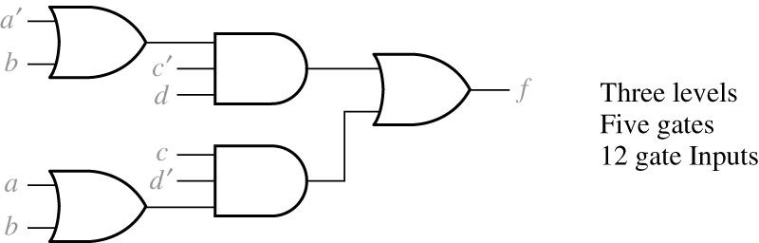
7.1 Multi-Level Gate Circuits
Three-level OR-AND-OR gate

Slide 7
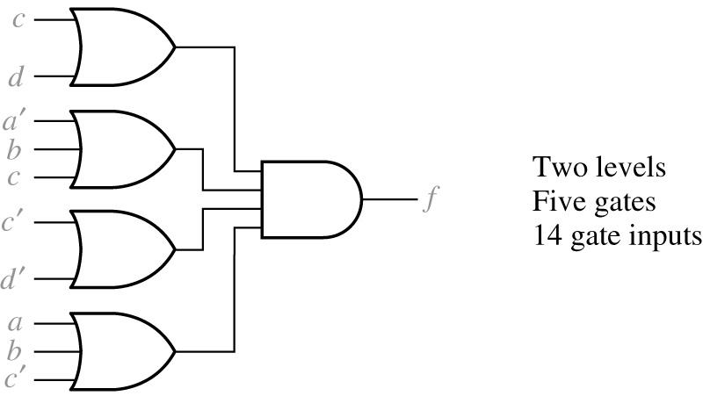
7.1 Multi-Level Gate Circuits
From 0’s on the Karnaugh map
Two-level OR-AND gate

Slide 8
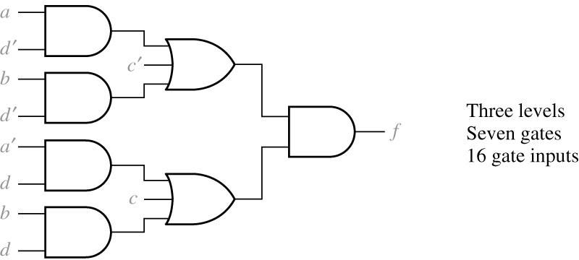
7.1 Multi-Level Gate Circuits
Using
If we multiply out
and
Three-level AND-OR-AND gate

Slide 9
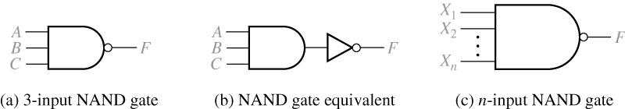

7.2 NAND and NOR Gates
NAND gate
NOR gate

Slide 10
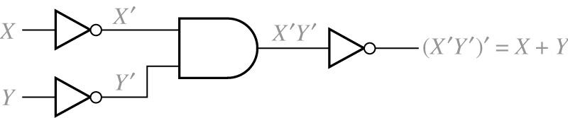
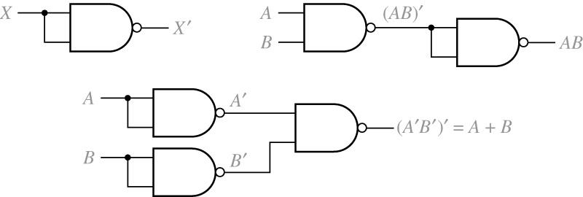
7.2 NAND and NOR Gates
OR realized by using AND and NOT
AND realized by using OR and NOT
NAND gate realization of NOT, AND, and OR

Slide 11
7.3 Design of Two-Level Circuits Using NAND and NOR Gates
DeMorgan’s laws
Conversion of a sum-of-products to several other two-level forms
AND-OR
NAND-NAND
OR-NAND
NOR-OR
NOR-NOR-NOT

Slide 12
7.3 Design of Two-Level Circuits Using NAND and NOR Gates
Conversion of a product-of-sums to several other two-level forms
OR-AND
NOR-NOR
AND-NOR
NAND-AND

Slide 13
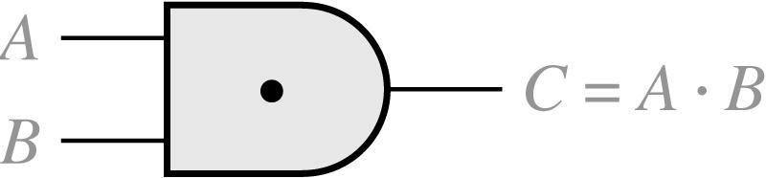
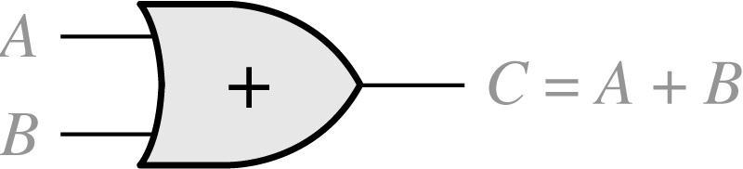
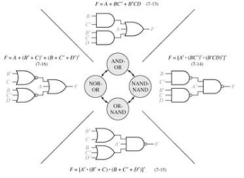
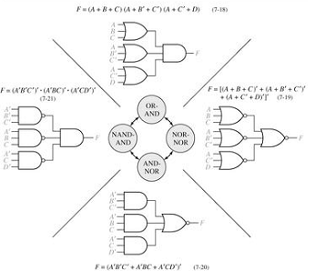
7.3 Design of Two-Level Circuits Using NAND and NOR Gates
Eight Basic Forms for Two-Level Circuits
Basic Conversion Exercise

Slide 14
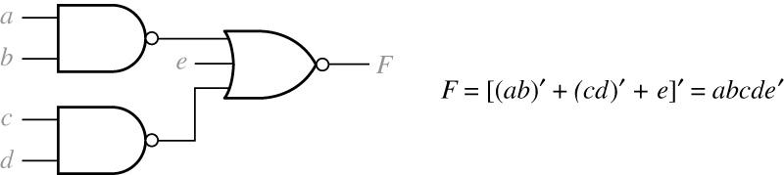
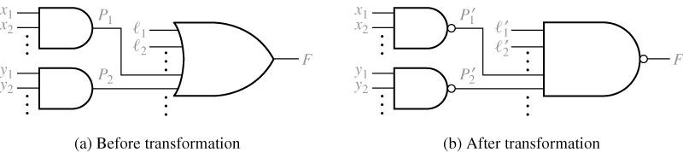
7.3 Design of Two-Level Circuits Using NAND and NOR Gates
NAND-NOR
AND-OR to NAND-NAND Transformation
: literals
: product terms

Slide 15
7.4 Design of Multi-Level NAND- and NOR-Gates Circuits
Procedure : multi-level NAND-gate circuits
- Simplify the switching function
- Design a multi-level circuit of AND and OR gates
- Number the levels starting with the output gate as level 1
- Replace all gates with NAND gates, leaving all interconnections
between gates unchanged
- Leave the inputs to levels 2,4,6,… unchanged

Slide 16
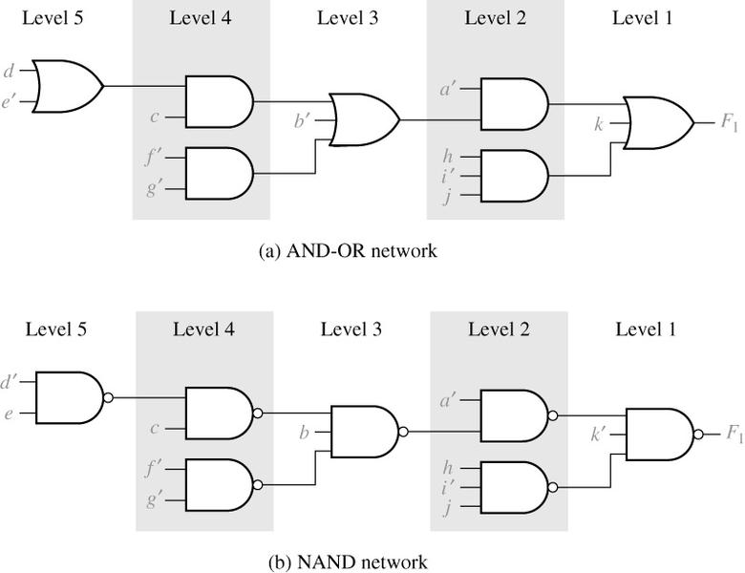
7.4 Design of Multi-Level NAND- and NOR-Gates Circuits
Example : Multi-Level Circuit Conversion to NAND Gates

Slide 17
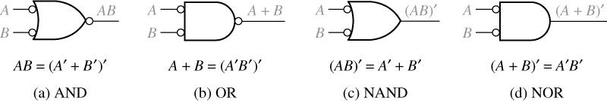
7.5 Circuit Conversion Using Alternative Gate Symbols
Inverter
Alternative Gate Symbols

Slide 18
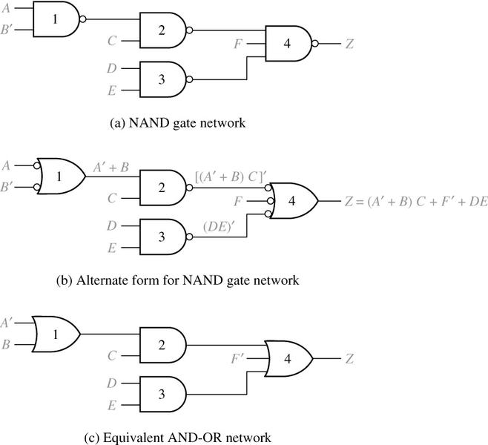
7.5 Circuit Conversion Using Alternative Gate Symbols
NAND Gate Circuit Conversion
Notes:
Reverse engineering

Slide 19
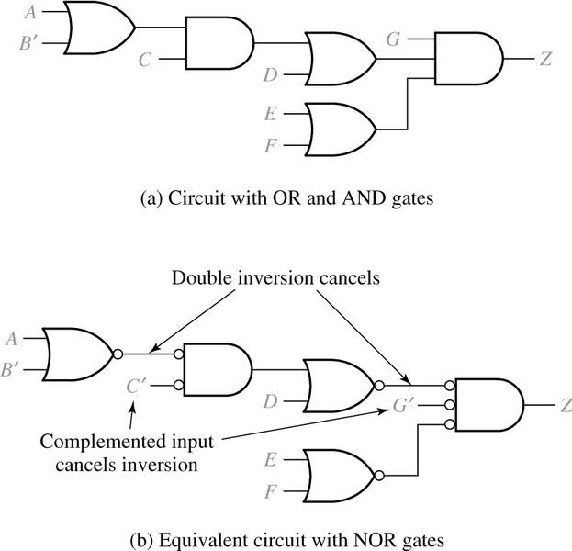
7.5 Circuit Conversion Using Alternative Gate Symbols
Conversion of AND-OR Gates to NOR Gates

Slide 20
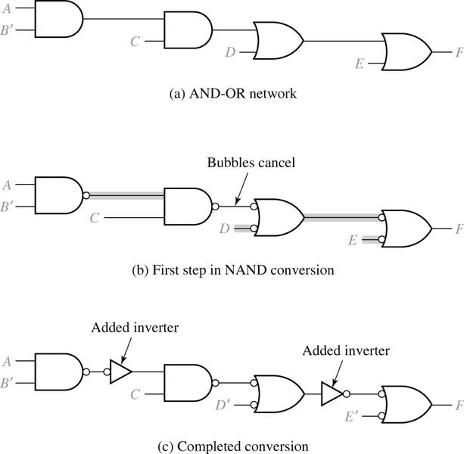
7.5 Circuit Conversion Using Alternative Gate Symbols
Conversion of AND-OR Gates to NAND Gates

Slide 21
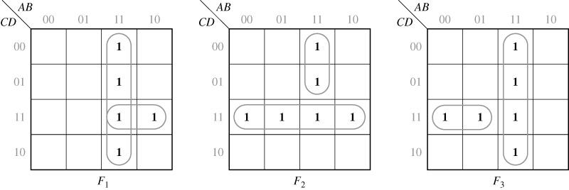
7.6 Design of Two-Level, Multiple-Output Circuits
Example : Design a circuit with four inputs and three outputs
Karnaugh Maps for Equations

Slide 22
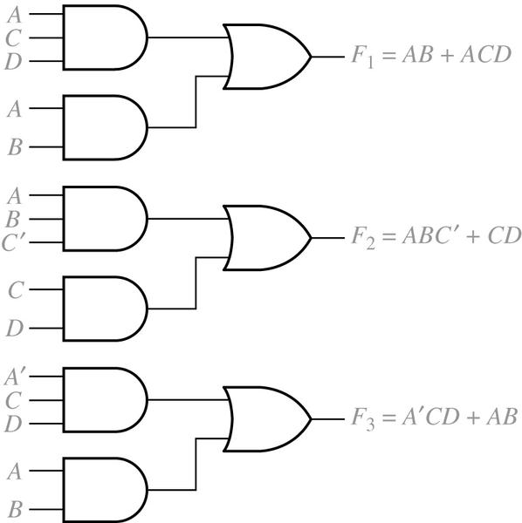
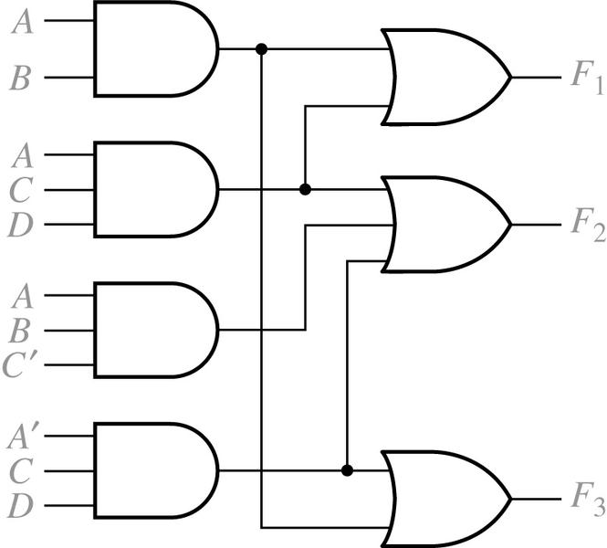
7.6 Design of Two-Level, Multiple-Output Circuits
Realization of Equations
Multiple-Output Realization of Equations

Slide 23
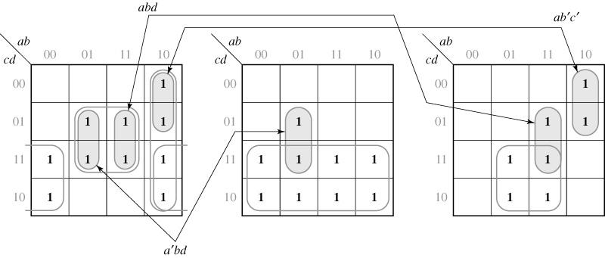
7.6 Design of Two-Level, Multiple-Output Circuits
Example : Design a multiple-output circuit with 4-inputs and 3-outputs
Karnaugh Maps for Equations
Local optimal < Global optimal

Slide 24
7.6 Design of Two-Level, Multiple-Output Circuits
If each function is minimized separately, the result is
10 gates,
25 gate inputs
Notes:
7 AND (no AND for c), 3 OR

Slide 25
7.6 Design of Two-Level, Multiple-Output Circuits
Determination of Essential Prime Implicants for Multiple-Output Realization
The minimal solution is
8 gates -20%
22 gate inputs -12%
Notes:
3 common AND, 2 local AND, 3 OR

Slide 26
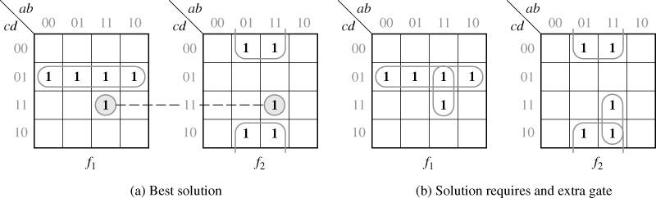
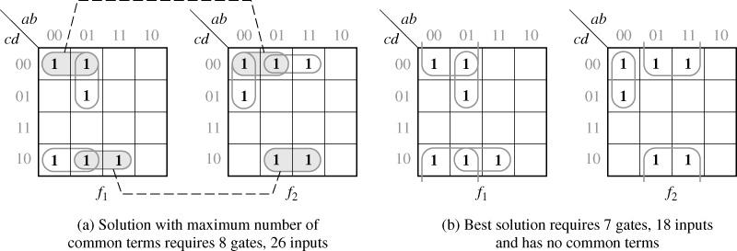
7.6 Design of Two-Level, Multiple-Output Circuits
5 gates
6 gates
Notes:
(4 AND, 1 OR), (4 AND, 1 OR), -2 AND

Slide 27
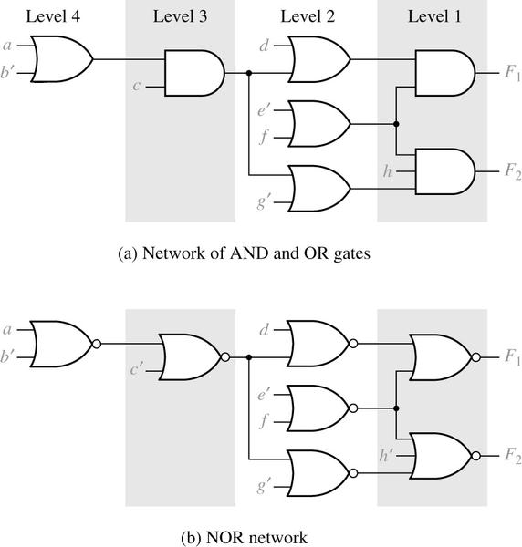
7.7 Multiple-Output NAND and NOR Circuits
Multi-output Circuit Conversion to NOR Gates

